Slide 1
MasterPiets (A Piet IDE)
Gabrielle Singh Cadieux
Toronto Hack && Tell: Round 16 March 6th, 2018

Slide 2
Piet is an esoteric visual programming language
visual: Piet programs are images

Slide 3
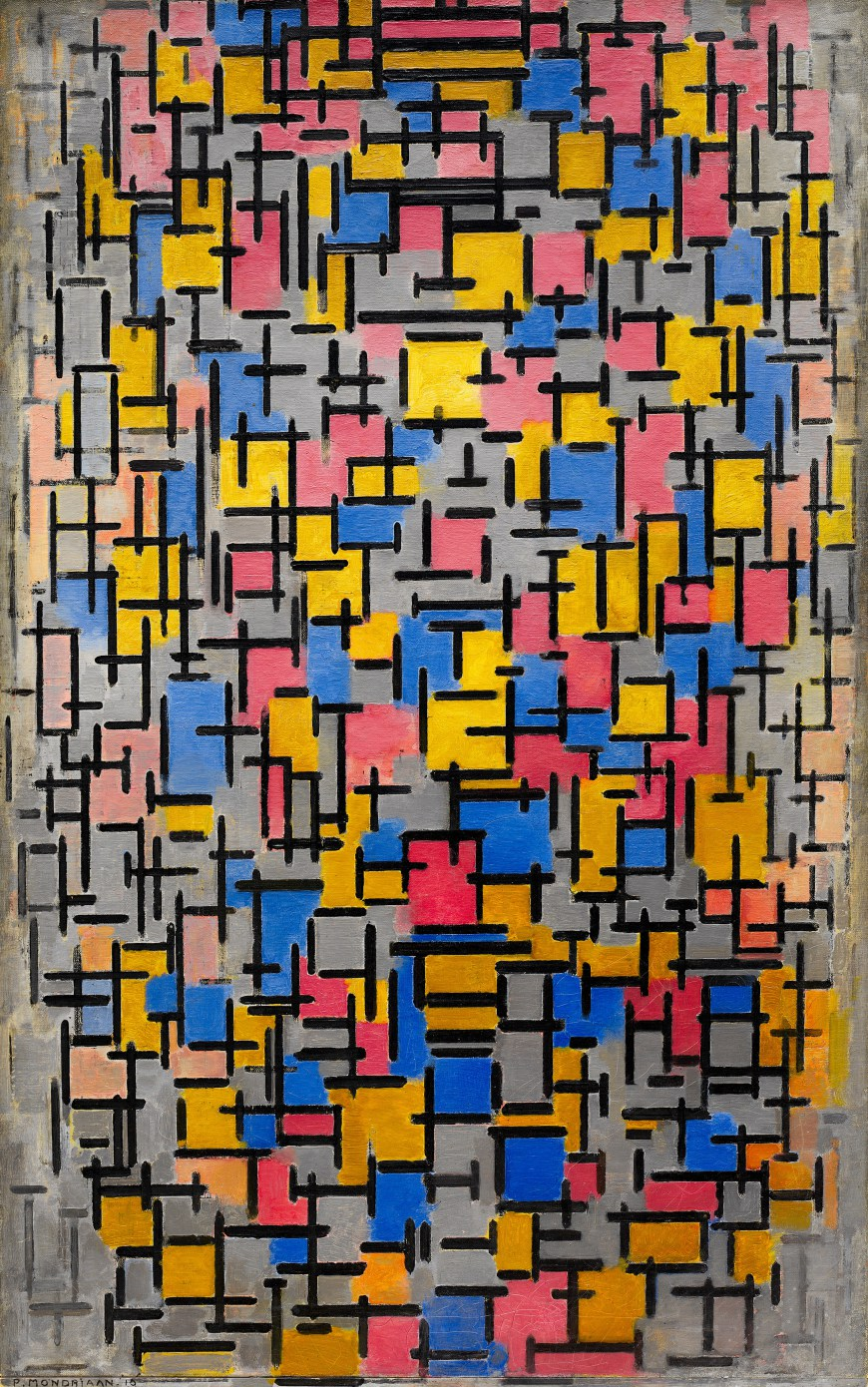
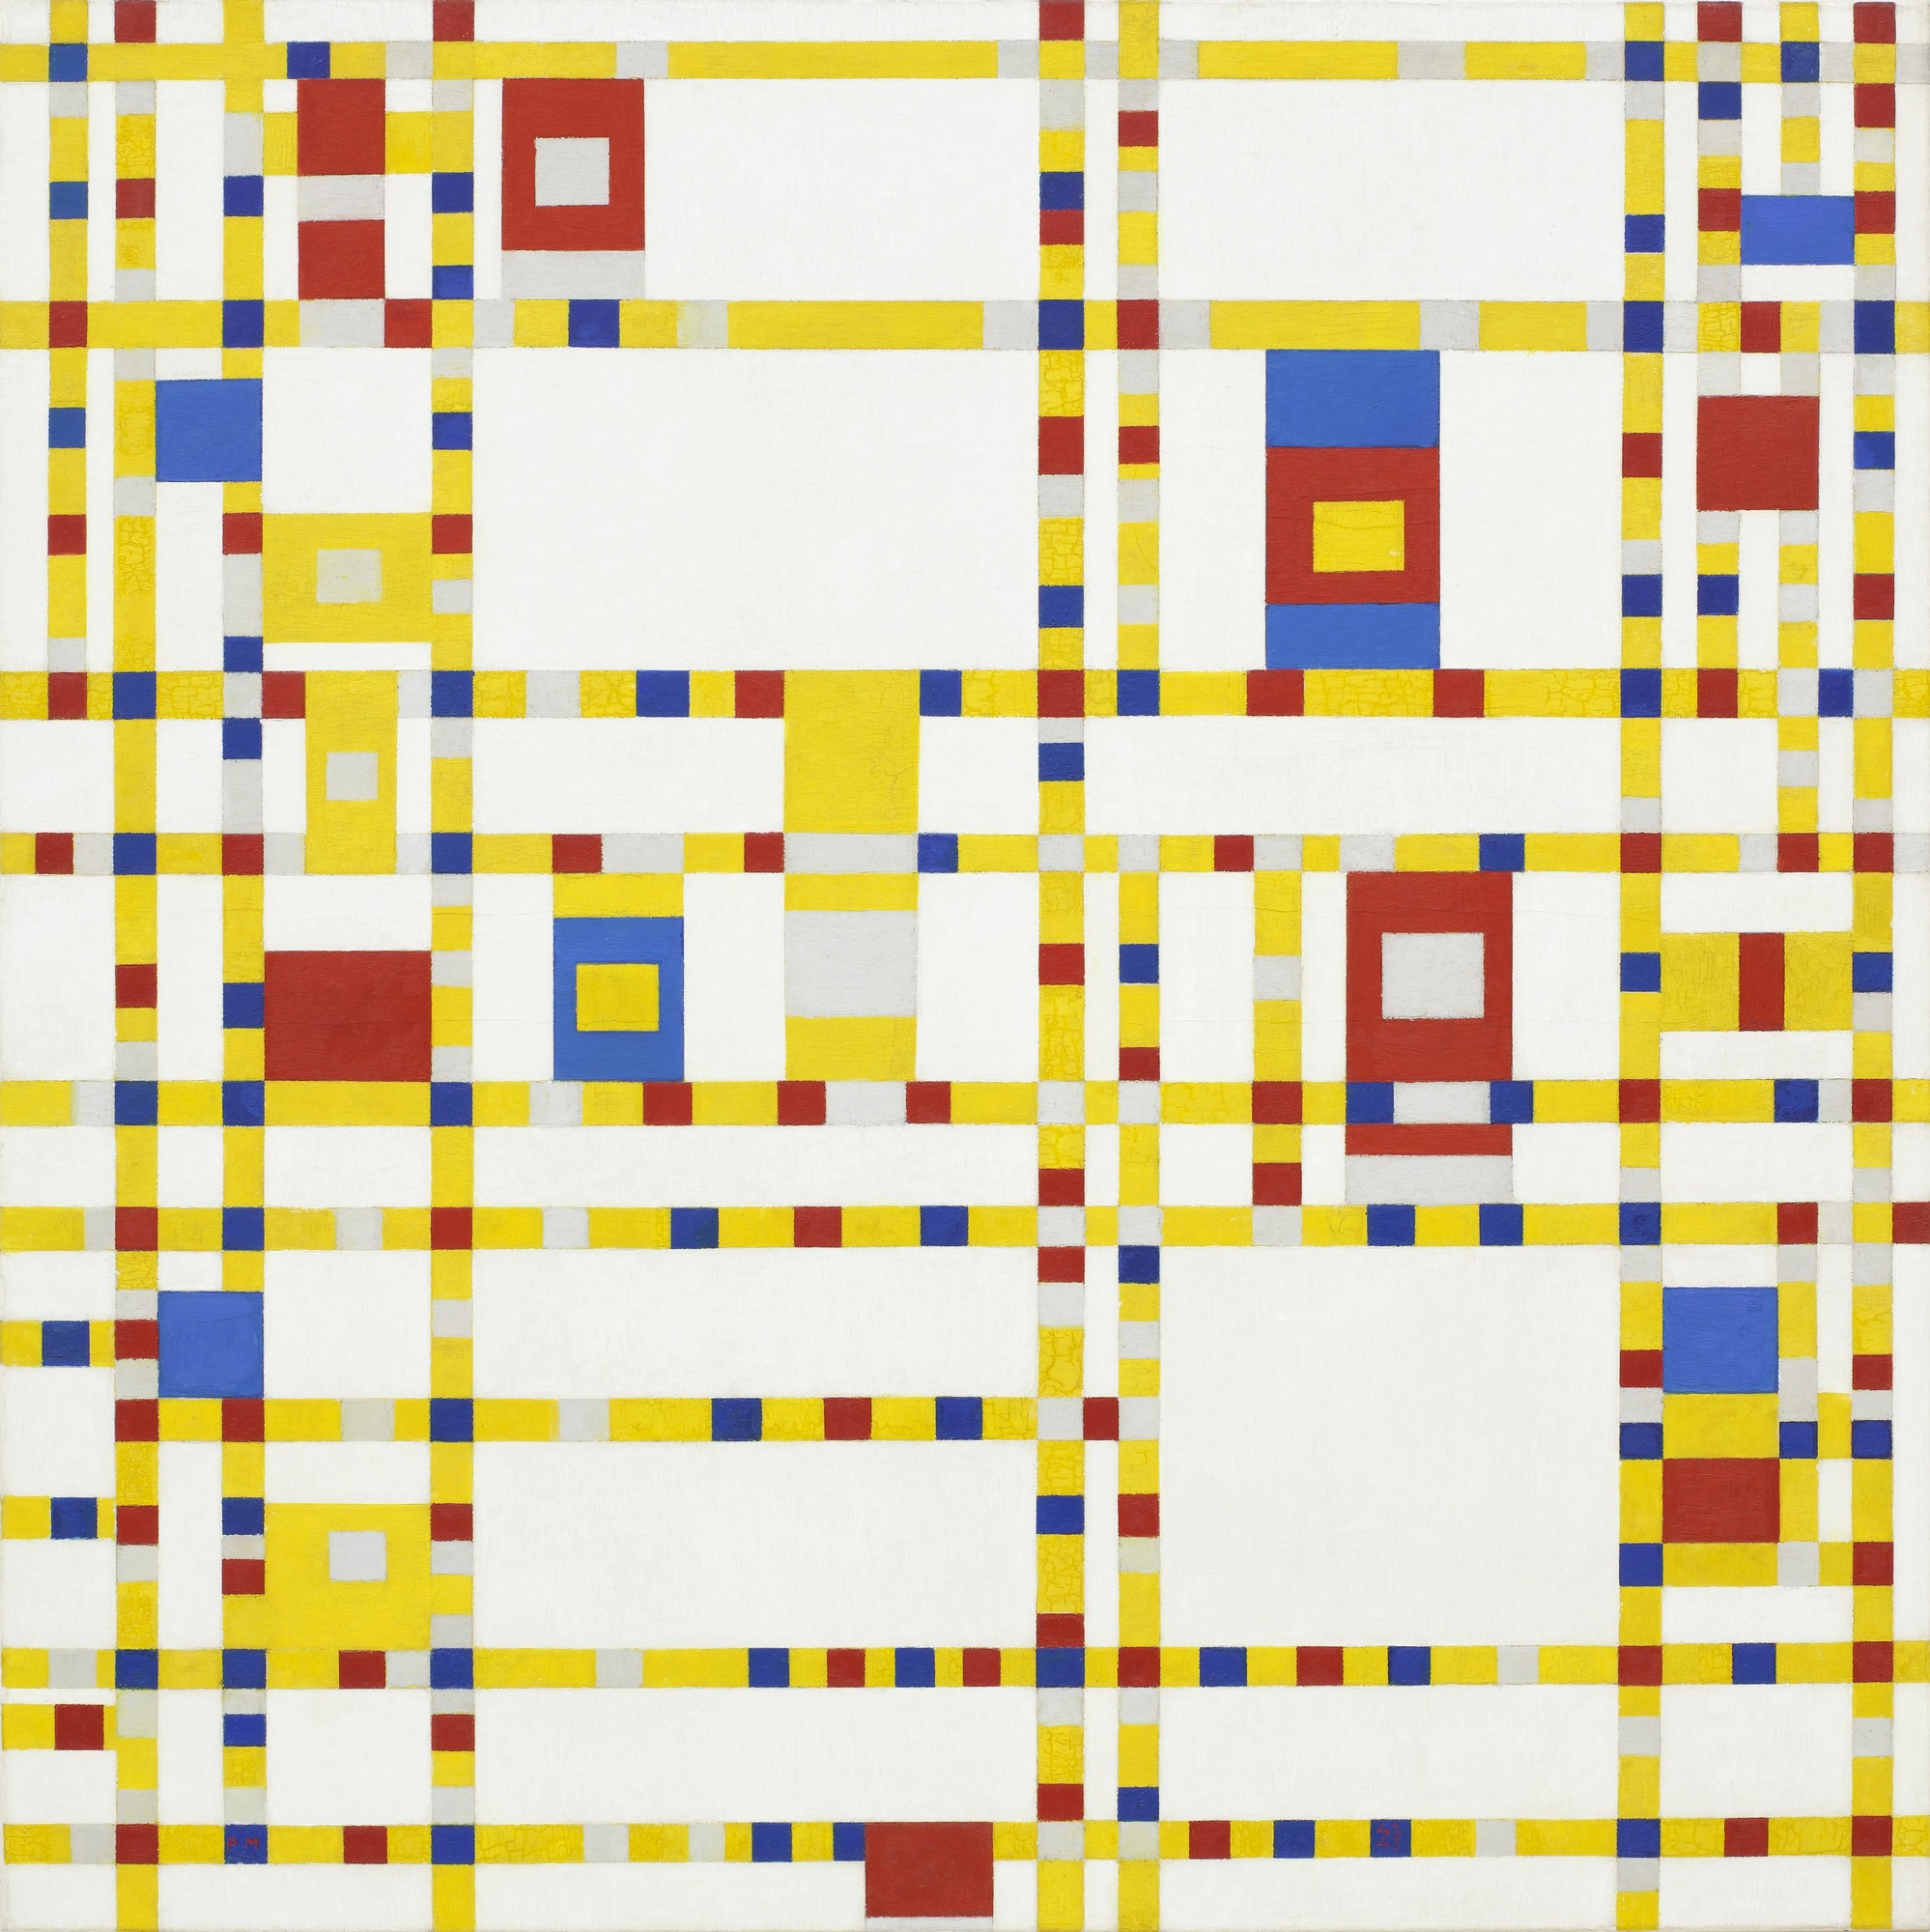
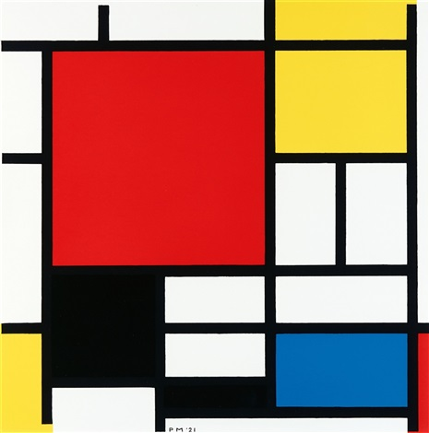
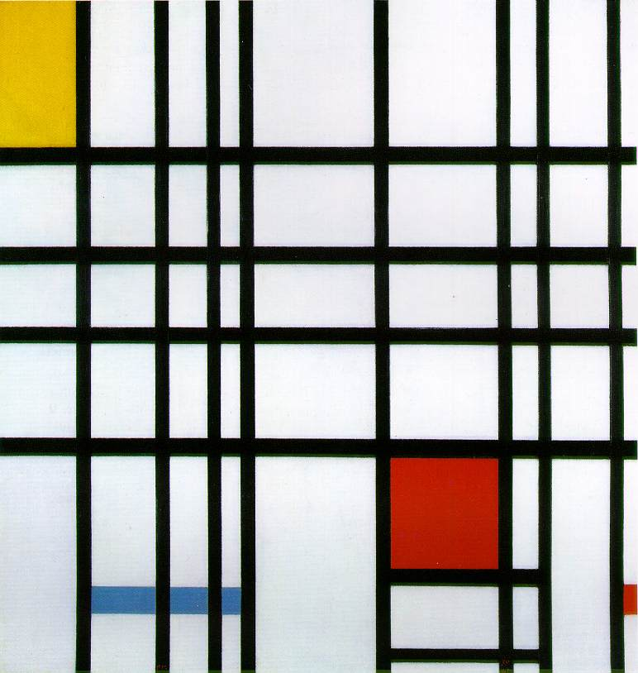
Example works by Mondrian
Piet is named after abstract artist Piet Mondrian

Slide 4
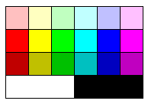
Piet programs contain only these colours: (6 hues x 3 lightness levels + black & white)
 |  | Lightness change
 |  | None | 1 darker | 2 darker
Hue change | None |  | PUSH | POP
 | 1 step | ADD | SUB | MUL
 | 2 steps | DIV | MOD | NOT
 | 3 steps | > | POINTER | SWITCH
 | 4 steps | DUP | ROLL | IN(num)
 | 5 steps | IN(char) | OUT(num) | OUT(char)
Piet palette
Piet instruction set

Slide 5
 |  | Lightness change
 |  | None | 1 darker | 2 darker
Hue change | None |  | PUSH | POP
 | 1 step | ADD | SUB | MUL
 | 2 steps | DIV | MOD | NOT
 | 3 steps | > | POINTER | SWITCH
 | 4 steps | DUP | ROLL | IN(num)
 | 5 steps | IN(char) | OUT(num) | OUT(char)
As the Piet interpreter moves around the image, each relative transition between colours produces a command

Slide 6
 |  | Lightness change
 |  | None | 1 darker | 2 darker
Hue change | None |  | PUSH | POP
 | 1 step | ADD | SUB | MUL
 | 2 steps | DIV | MOD | NOT
 | 3 steps | > | POINTER | SWITCH
 | 4 steps | DUP | ROLL | IN(num)
 | 5 steps | IN(char) | OUT(num) | OUT(char)

Slide 7
 |  | Lightness change
 |  | None | 1 darker | 2 darker
Hue change | None |  | PUSH | POP
 | 1 step | ADD | SUB | MUL
 | 2 steps | DIV | MOD | NOT
 | 3 steps | > | POINTER | SWITCH
 | 4 steps | DUP | ROLL | IN(num)
 | 5 steps | IN(char) | OUT(num) | OUT(char)

Slide 8
 |  | Lightness change
 |  | None | 1 darker | 2 darker
Hue change | None |  | PUSH | POP
 | 1 step | ADD | SUB | MUL
 | 2 steps | DIV | MOD | NOT
 | 3 steps | > | POINTER | SWITCH
 | 4 steps | DUP | ROLL | IN(num)
 | 5 steps | IN(char) | OUT(num) | OUT(char)

Slide 9
There are so many ways to produce the same command…
Two Piet programs can be functionally-equivalent but look very different
Let’s try Hello World...

Slide 10
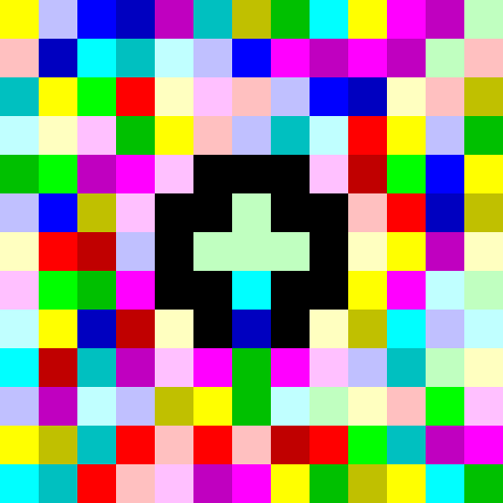
Hello World 1

Slide 11
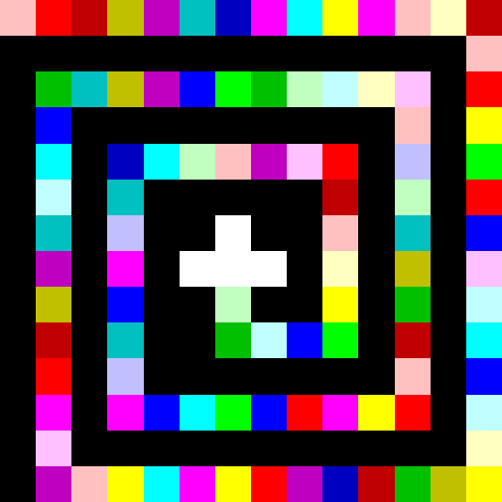
Hello World 2

Slide 12
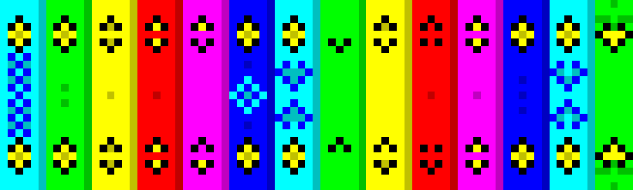
Hello World 3

Slide 13
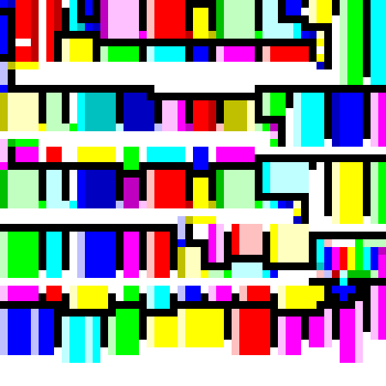
Hello World 4

Slide 14
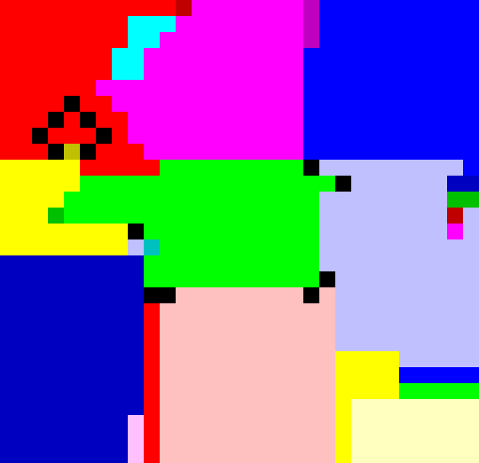
Hello World 5

Slide 15
Piet interpreter starts at top-left...
 |  | Lightness change
 |  | None | 1 darker | 2 darker
Hue change | None |  | PUSH | POP
 | 1 step | ADD | SUB | MUL
 | 2 steps | DIV | MOD | NOT
 | 3 steps | > | POINTER | SWITCH
 | 4 steps | DUP | ROLL | IN(num)
 | 5 steps | IN(char) | OUT(num) | OUT(char)

Slide 16
Moves to adjacent block to right...
 |  | Lightness change
 |  | None | 1 darker | 2 darker
Hue change | None |  | PUSH | POP
 | 1 step | ADD | SUB | MUL
 | 2 steps | DIV | MOD | NOT
 | 3 steps | > | POINTER | SWITCH
 | 4 steps | DUP | ROLL | IN(num)
 | 5 steps | IN(char) | OUT(num) | OUT(char)
PUSH 72
The value pushed is the number of pixels in the block

Slide 17
Continues moving right...
 |  | Lightness change
 |  | None | 1 darker | 2 darker
Hue change | None |  | PUSH | POP
 | 1 step | ADD | SUB | MUL
 | 2 steps | DIV | MOD | NOT
 | 3 steps | > | POINTER | SWITCH
 | 4 steps | DUP | ROLL | IN(num)
 | 5 steps | IN(char) | OUT(num) | OUT(char)
PUSH 72
OUT(char) → H

Slide 18
 |  | Lightness change
 |  | None | 1 darker | 2 darker
Hue change | None |  | PUSH | POP
 | 1 step | ADD | SUB | MUL
 | 2 steps | DIV | MOD | NOT
 | 3 steps | > | POINTER | SWITCH
 | 4 steps | DUP | ROLL | IN(num)
 | 5 steps | IN(char) | OUT(num) | OUT(char)
PUSH 72
OUT(char) → H
PUSH 101

Slide 19
 |  | Lightness change
 |  | None | 1 darker | 2 darker
Hue change | None |  | PUSH | POP
 | 1 step | ADD | SUB | MUL
 | 2 steps | DIV | MOD | NOT
 | 3 steps | > | POINTER | SWITCH
 | 4 steps | DUP | ROLL | IN(num)
 | 5 steps | IN(char) | OUT(num) | OUT(char)
PUSH 72
OUT(char) → H
PUSH 101
OUT(char) → e

Slide 20
Rotates direction after hitting an edge
 |  | Lightness change
 |  | None | 1 darker | 2 darker
Hue change | None |  | PUSH | POP
 | 1 step | ADD | SUB | MUL
 | 2 steps | DIV | MOD | NOT
 | 3 steps | > | POINTER | SWITCH
 | 4 steps | DUP | ROLL | IN(num)
 | 5 steps | IN(char) | OUT(num) | OUT(char)
PUSH 72
OUT(char) → H
PUSH 101
OUT(char) → e
PUSH 108

Slide 21
Continues moving down...
 |  | Lightness change
 |  | None | 1 darker | 2 darker
Hue change | None |  | PUSH | POP
 | 1 step | ADD | SUB | MUL
 | 2 steps | DIV | MOD | NOT
 | 3 steps | > | POINTER | SWITCH
 | 4 steps | DUP | ROLL | IN(num)
 | 5 steps | IN(char) | OUT(num) | OUT(char)
PUSH 72
OUT(char) → H
PUSH 101
OUT(char) → e
PUSH 108
DUP

Slide 22
The interpreter may not travel through every block in the image, so we can put whatever we want in those areas...

Slide 23

The interpreter passes around the border of the image and stops...
So we can put whatever we want in the centre
Hello World 6

Slide 24
Developing with MasterPiets

Slide 25
Many Piet-specific development tools exist (of course, you can create Piet programs with graphics software as well).
I created MasterPiets because I wanted a Piet IDE that:
Was easy/quick to start using (incl. not needing to be downloaded)
Had a simple and elegant interface
Was powerful enough to manipulate large images
Included a debugger with standard capabilities

Slide 26
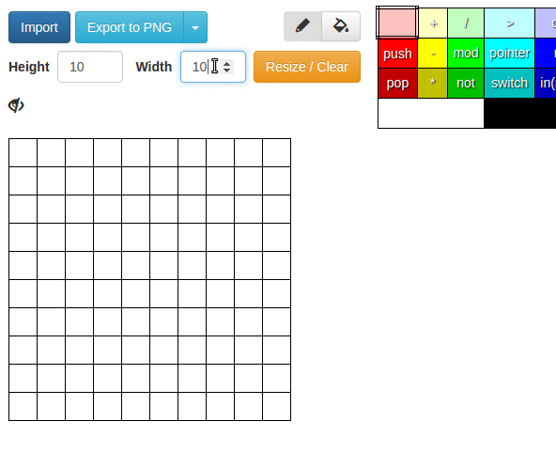
Choose the image size

Slide 27
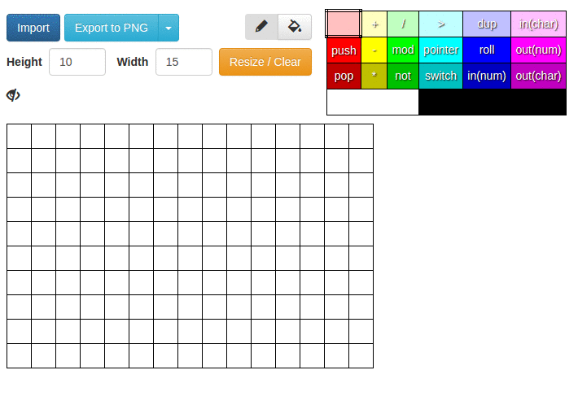
For each colour, the command is displayed that corresponds to a transition from the selected colour
Paint individual pixels or an entire block

Slide 28
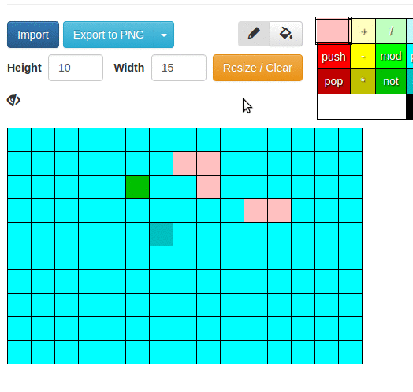
View the pixel count for each block, or make all pixel counts visible

Slide 29
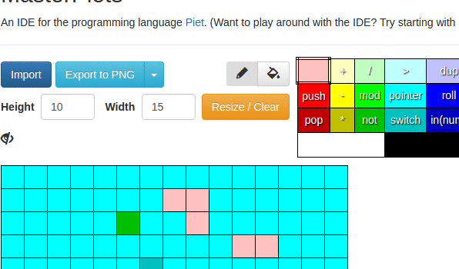
Export a program to a file (can be scaled up to show details)

Slide 30
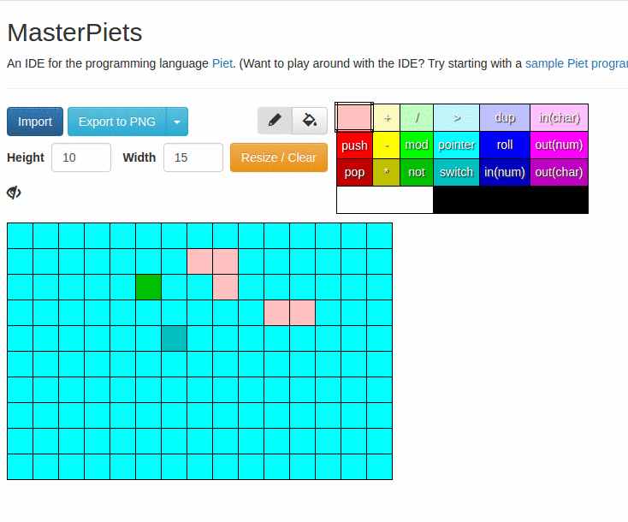
Import a program from a file

Slide 31
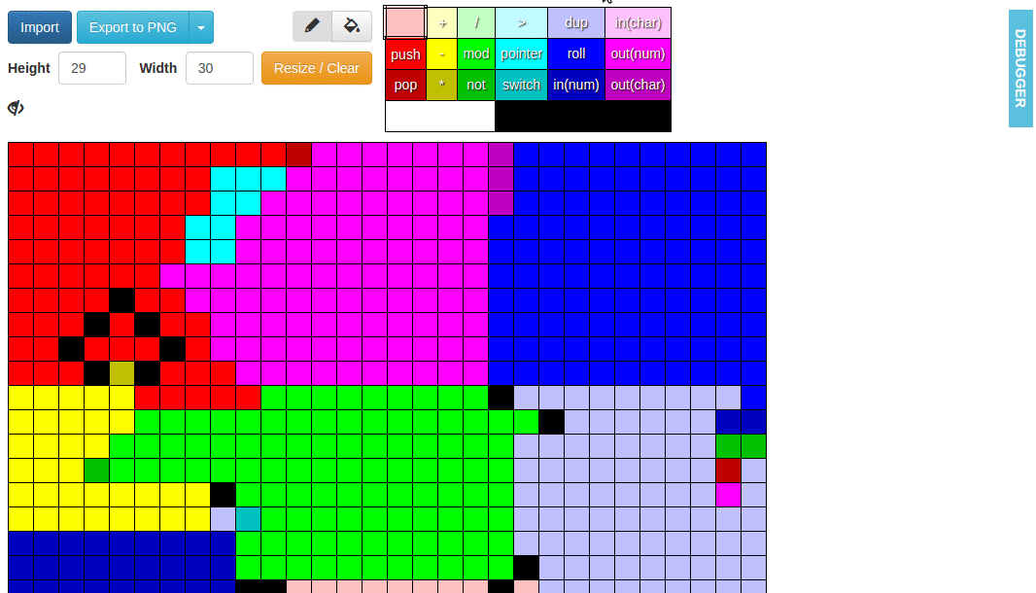
command
history
current command
controls
direction
stack
input
output
Run the program and watch the current state of the interpreter change

Slide 32
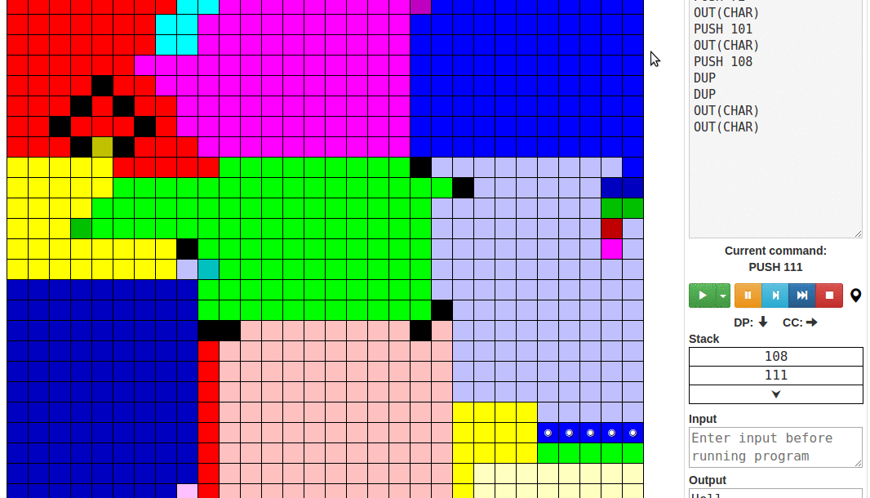
Pause the interpreter / Step through the program

Slide 33
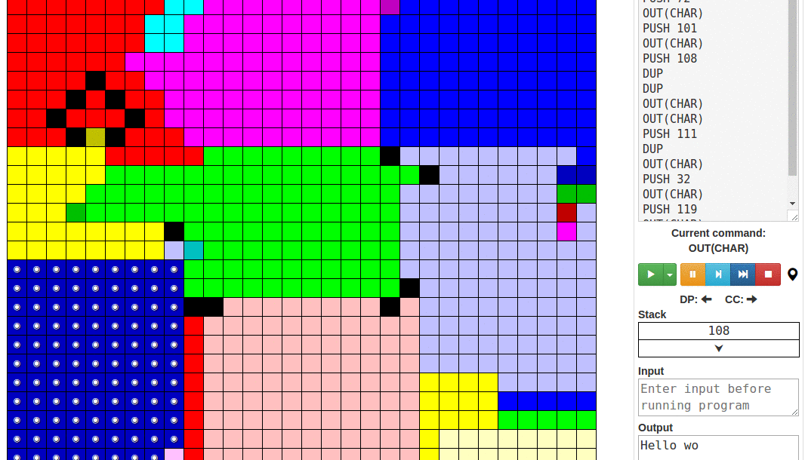
Set a breakpoint on a block

Slide 34
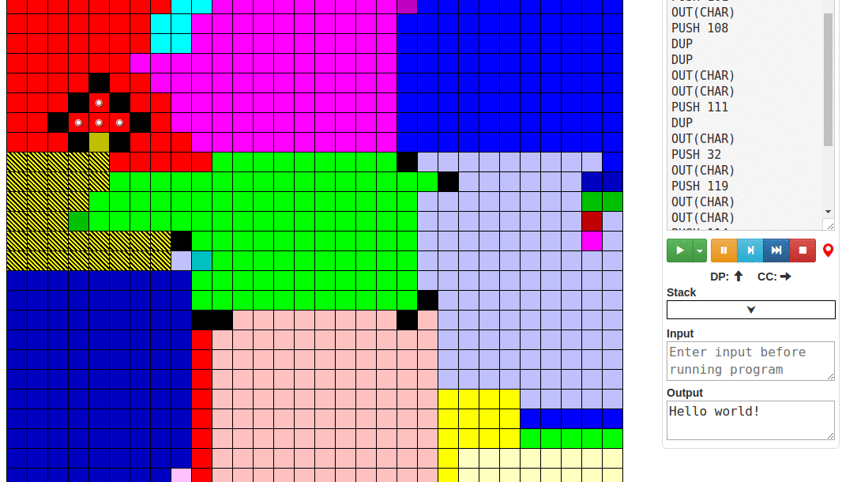
Look back through the command history to trace the interpreter’s path

Slide 35
Architecture
Next step
Written in JavaScript, using React.js for the UI
Runs entirely in the browser
Uses Jimp for image importing/exporting
Image recognition of a Piet program from a photograph (of a drawing, painting, etc.)

